Slide 1
NoSQL Exploration
Junai Abbasi
Nikhil Mungel
Vaishak Suresh

Slide 2
MongoDB
Mongo as in HuMongous.
We used Github Events to explore MongoDB’s capabilities.
Downloaded all events for 2012 (~55GB)
Data too big for laptops, so used 1 month’s data (~5 GB)

Slide 3
Github Events
No direct way to download, GitHub only provides an API, that is rate-limited.
Used GithubArchive.org to get old data.
Events we focused on:
PushEvent
WatchEvent
IssueEvent
FollowEvent

Slide 4
Storage
Github_events was the db we used.
Each event was a separate collection ex: watch_events, push_events
Data already in JSON format – Minimal processing.

Slide 5
Some interesting queries
Top repositories
Top users
Repositories with most issues
Most watched repositories

Slide 6
Lessons learnt and problems faced
Unicode characters were not properly encoded.
Since each event was unique, MongoDB’s ‘_id’ was good enough.
Grouping does not work with large data (>1000), Aggregation is the alternative.
Sharding on the same machine is not very helpful

Slide 7
MongoDB - Demo

Slide 8
GitHub Top Ten repositories
Analyzed full one year data to find open and closed issues
Data Set Publishing Language (DSPL) format used for generating graphs on google.com
http://www.google.com/publicdata/directory
Here are the findings:

Slide 9
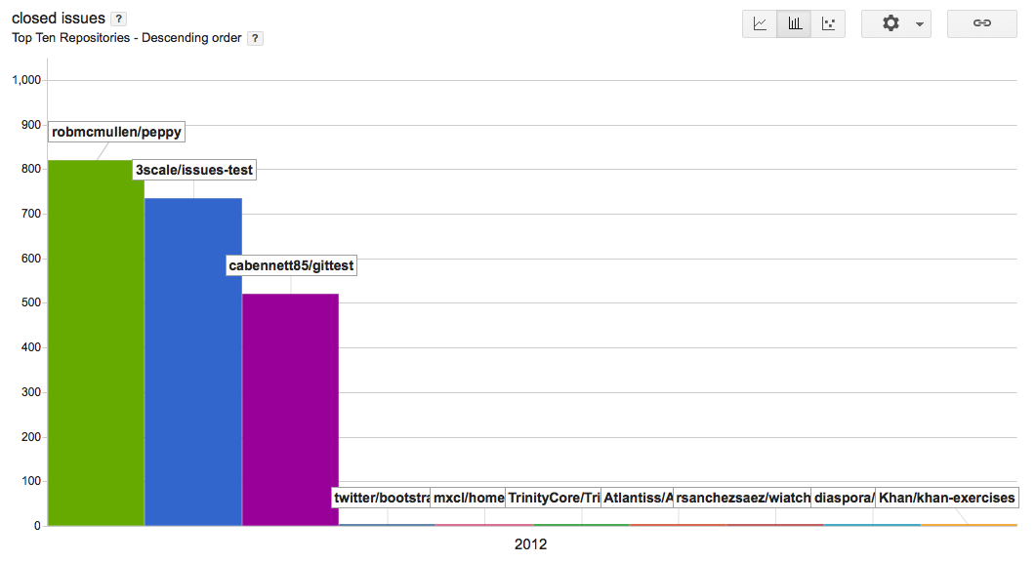
Closed Issues

Slide 10
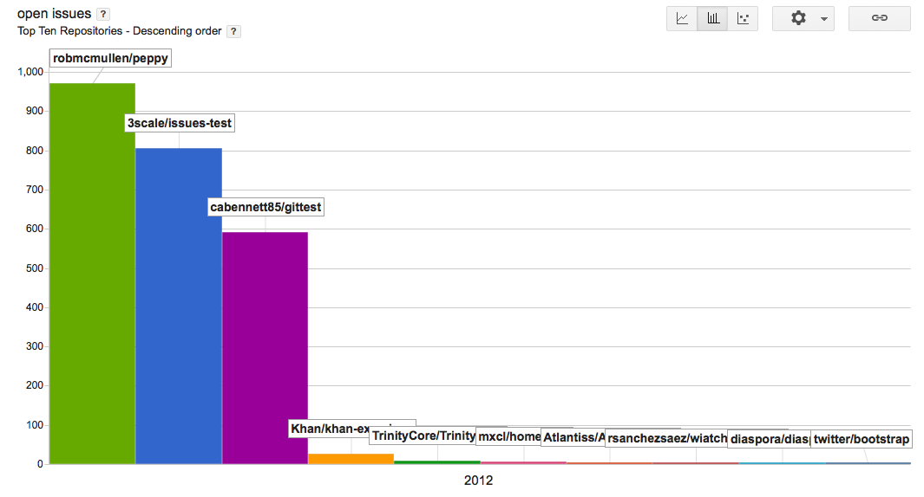
Open Issues

Slide 11
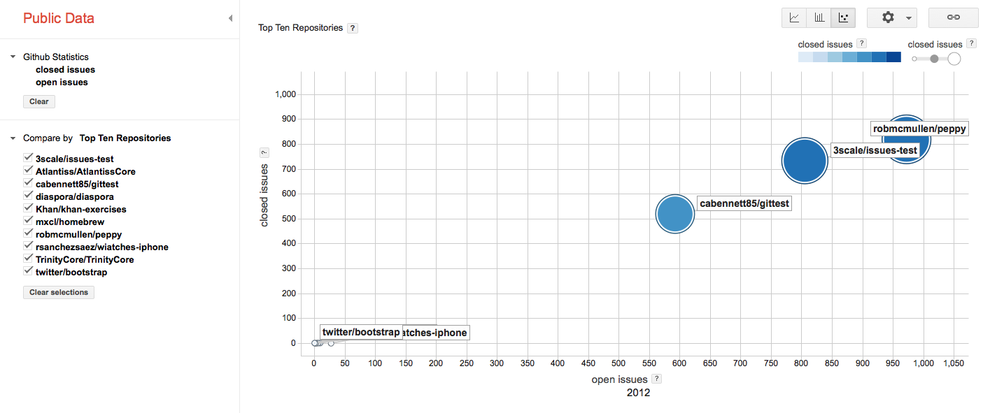
Open Closed Issues

